Slide 1
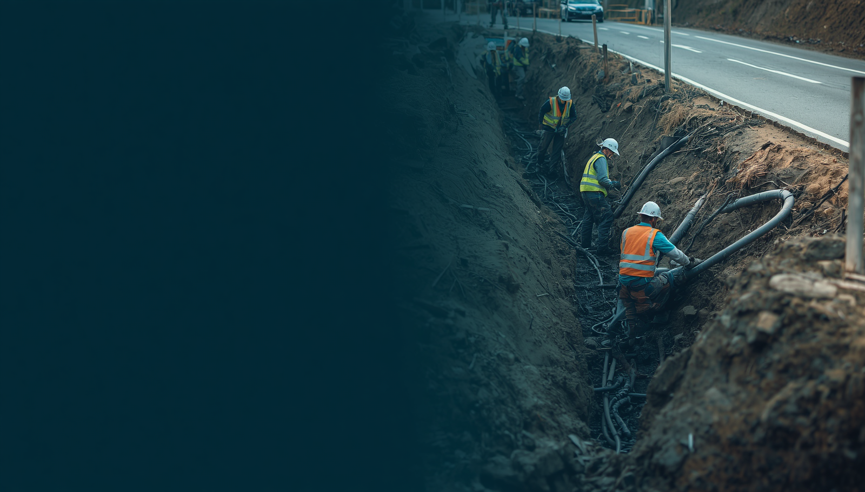

Recent Amendments
to Louisiana Dig Law: SB469 & HB464
Effective August 1, 2026
The information presented herein is for general information purposes only and is not legal advice.
Always consult with an attorney for advice on your specific question or issue.

Slide 2
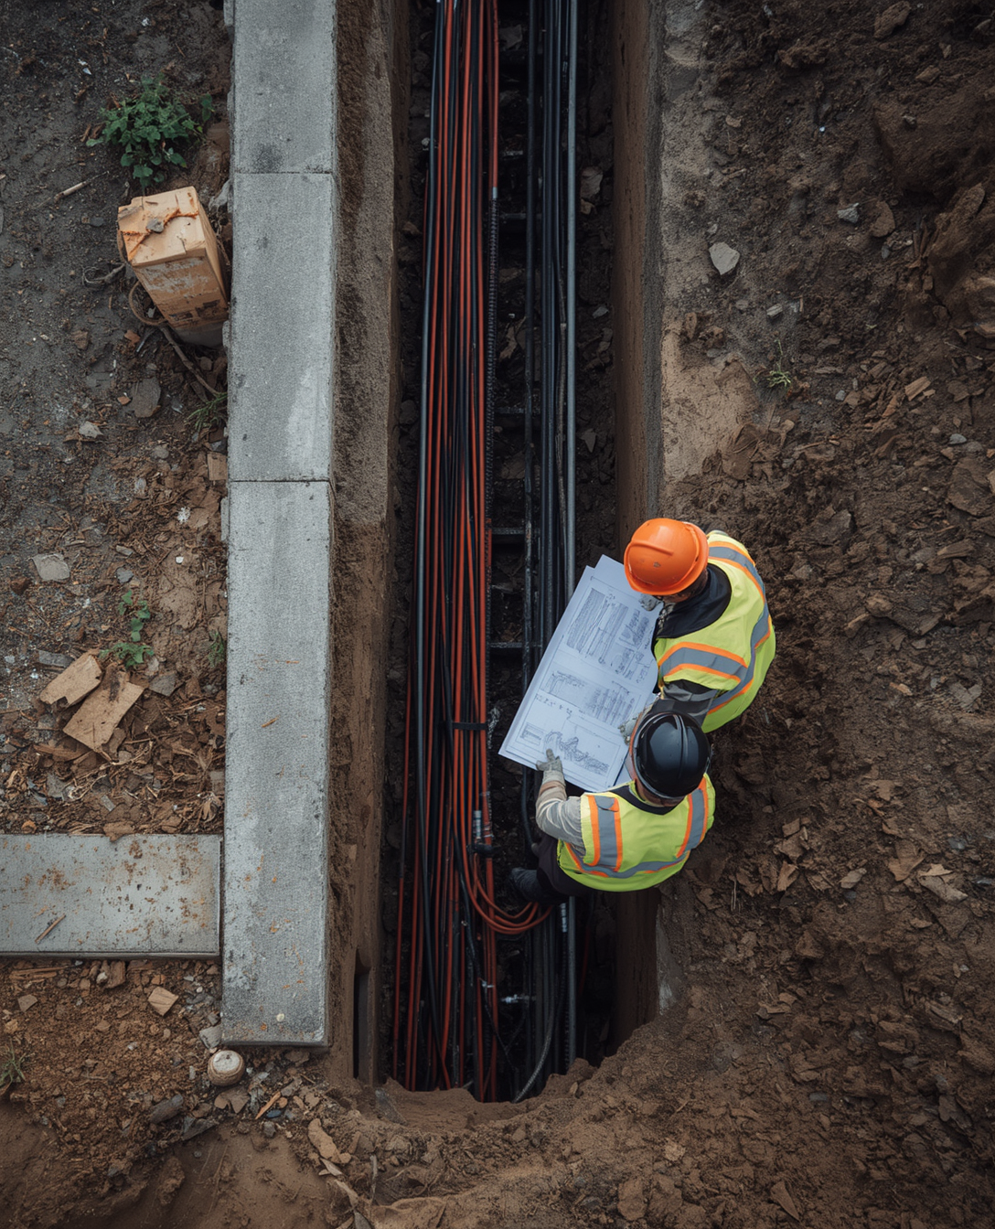
Agenda
An overview of recent legislative changes, key requirements, and BEAD project coordination under SB469 & HB464, effective August 1, 2026.
1.
Legislative Amendments & Key Requirements
2.
BEAD Project Processes & Coordination
02
3.
Compliance, Contacts & Q&A

Slide 3


Legislative Context
HB464 & SB469 signed into law — effective August 1, 2026, to enhance safety and compliance in underground excavation.
Setting the Stage for Change
Both bills were signed to strengthen coordination, safety, and compliance in underground excavation. Louisiana 811 continues to serve as the central hub for utility coordination statewide.
03
Effective August 1, 2026 — compliance is mandatory for all utility operators.

Slide 4
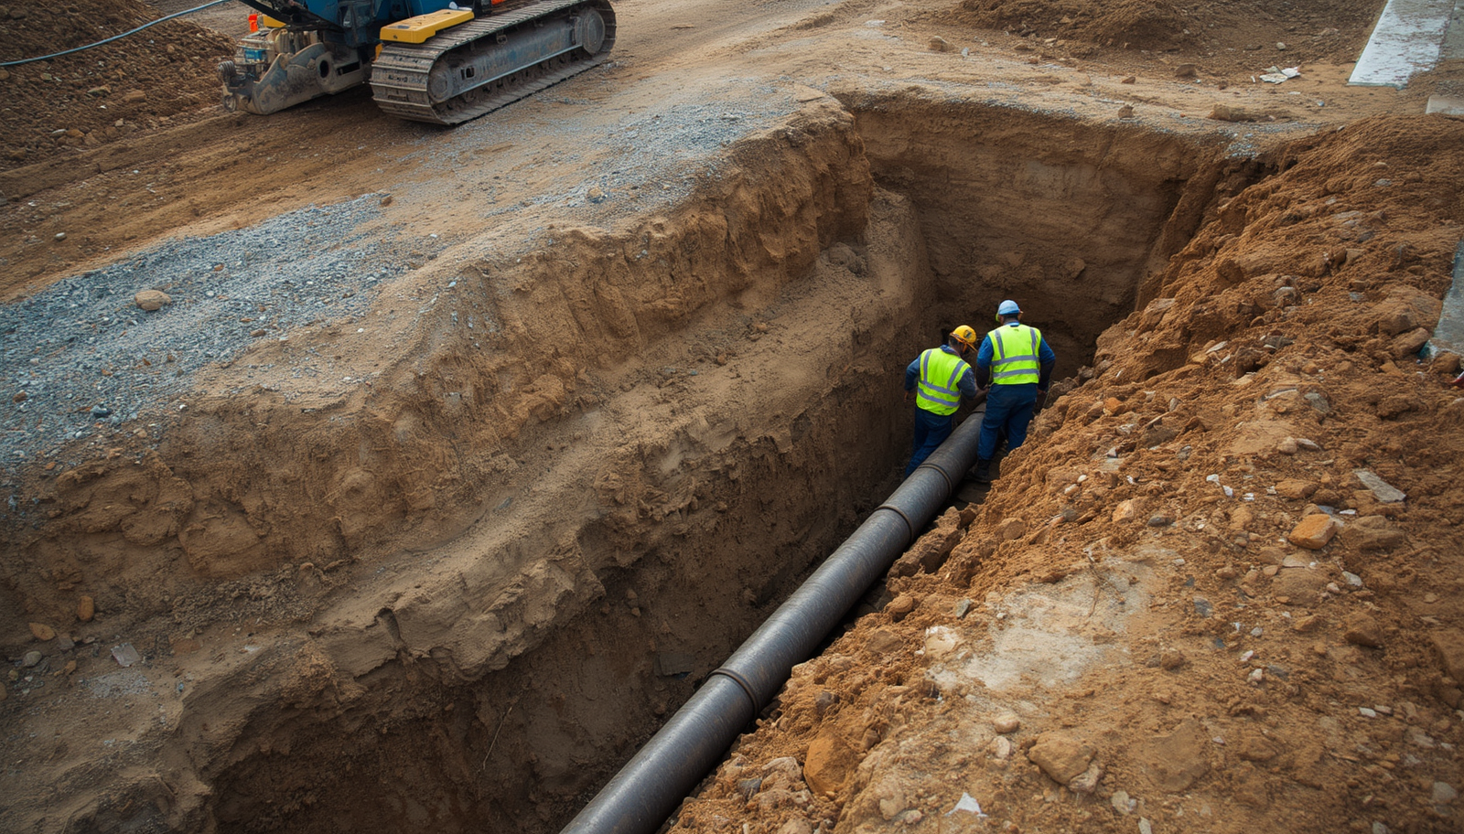
Damage Reporting Expansion
HB464
New requirements strengthen incident reporting and ensure coordinated response across all affected utility members.
Existing Excavator Obligation
01
Current law requires excavators to notify affected utility owners and operators directly when damage to underground facilities occurs during excavation.
Report to Louisiana 811
02
HB464 mandates that all damage incidents must also be reported to Louisiana 811, creating a centralized record of infrastructure damage events.
Coordinated Member Response
03
Upon receiving a damage report, Louisiana 811 notifies all affected members to ensure a fully coordinated response and enhanced public safety.
04

Slide 5

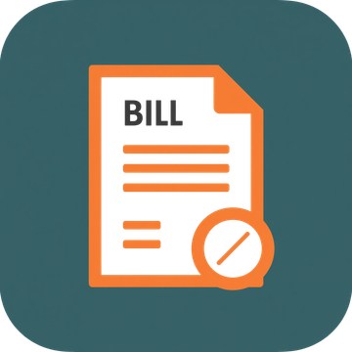
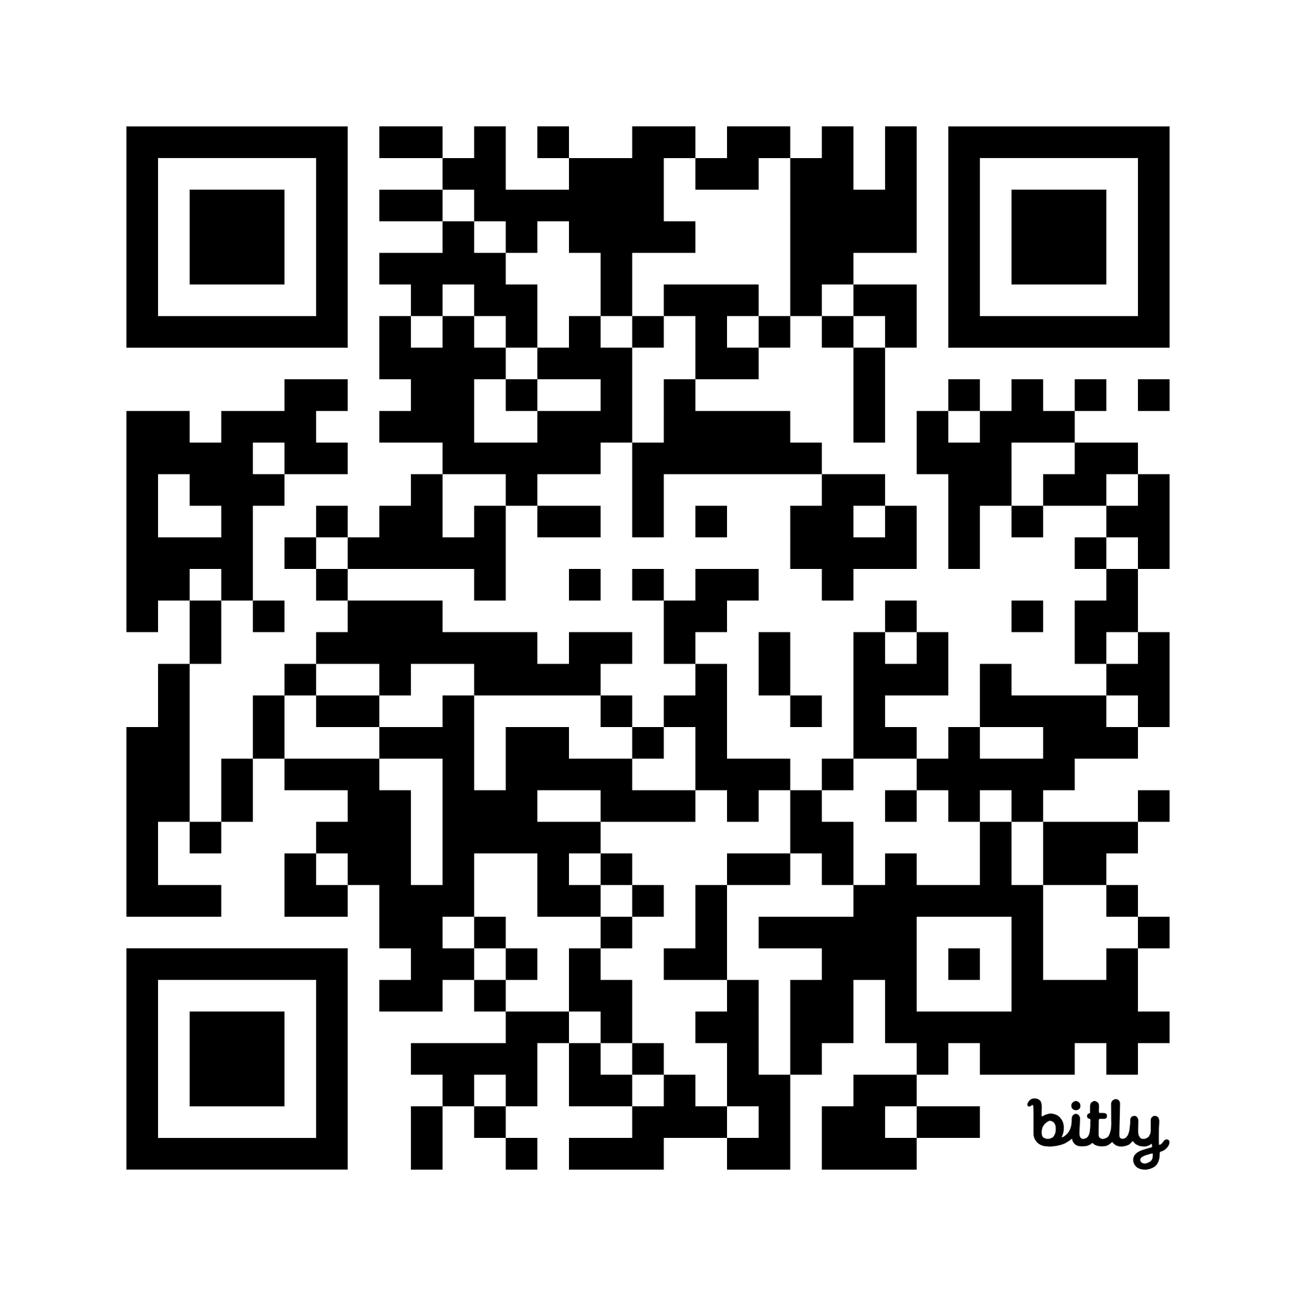
HB464
Summary
Companion legislation to SB469, signed by the Governor and effective August 1, 2026.
HB464: Complementing the Dig Law Amendments
Passed and signed by the Governor, HB464 takes effect August 1, 2026, alongside SB469. It complements SB469 amendments to strengthen underground excavation safety. Full text available at: legis.la.gov — members are strongly encouraged to review the complete legislation.
Review the full text
05
https://bit.ly/HB464

Slide 6


SB469
Effective August 1, 2026
Section Overview

Slide 7


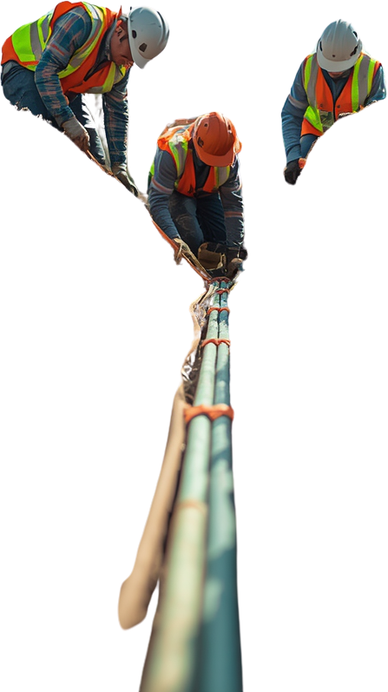


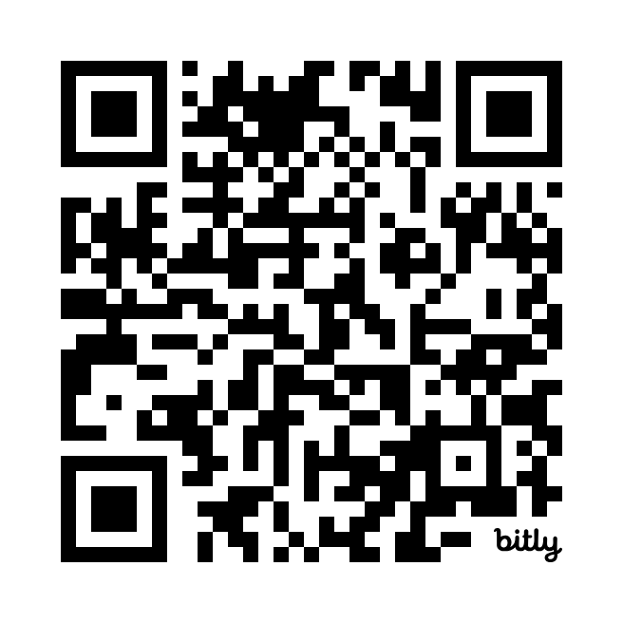
SB469
Overview
Positive Response
Enforcement Authority
All 811 members must confirm facility marking or no-conflict notification
Officers may stop excavation if a reasonable violation is identified
Mandatory Membership
BEAD Work Requirements
All underground utility operators required to join 811 (with noted exceptions)
Specific coordination and ticketing rules for BEAD-funded excavation projects
Review the full text
06
https://bit.ly/LASB469

Slide 8
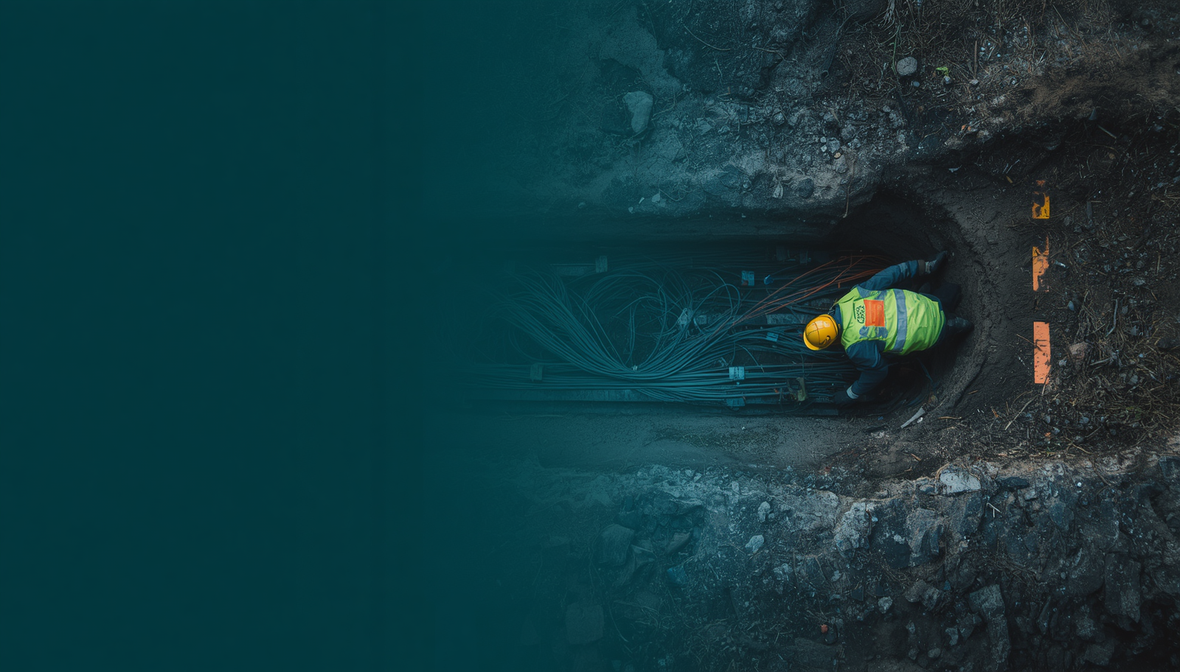
Positive Response Requirements
1.
Receive
Member receives locate request through Louisiana 811 system
2.
Confirm
Confirm facility marking or no conflict via Louisiana 811 Positive Response
Communicate
Utilize the Louisiana 811 Ticket Talk feature within the 811 Online Ticket Portal to address
Inquiries and concerns.
3.
07
4.
Implement
Contact lalead@occinc.com for Positive Response implementation support

Slide 9
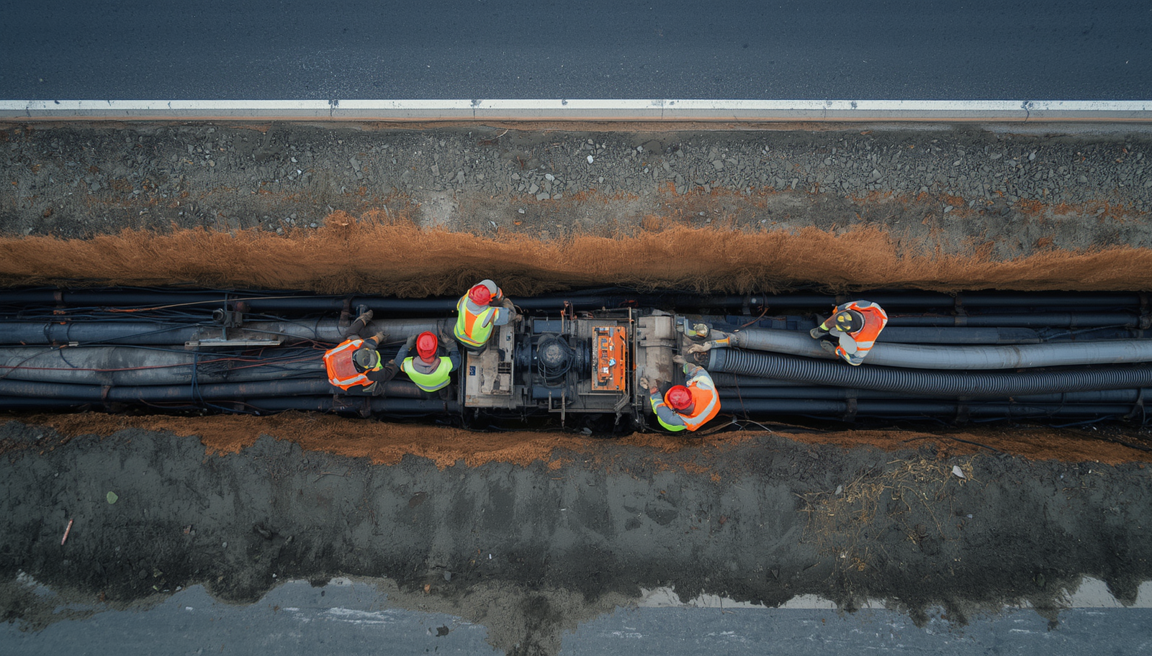
Mandatory Membership
  All underground utility owners and operators must be Louisiana 811 members under SB469, effective August 1, 2026.
All Operators Must Join
01
Every owner or operator of underground utilities or facilities is required to become a member of Louisiana 811 under the new law.
Noted Exceptions
02
Exceptions include:
Sewerage & Water Board of New Orleans
Jefferson Parish Water & Sewerage
City of Kenner
Why Membership Matters
03
Full membership ensures effective coordination, regulatory compliance, and improved safety across all excavation activities statewide.
08

Slide 10

Enforcement Officer Authority
1.
2.
3.
Power to Stop Excavation
Violation Examples
Compliance & Safety Focus
An enforcement officer may stop excavation if reasonable cause of a violation exists under the updated dig law.
Includes:
No valid or expired locate ticket
Excavation in unmarked or improperly marked areas
Other visible law breaches.
Enforcement authority is designed to increase compliance, protect infrastructure, and reinforce public safety standards.
09

Slide 11
BEAD Project Requirements Under SB469
Effective August 1, 2026
Section Overview

Slide 12
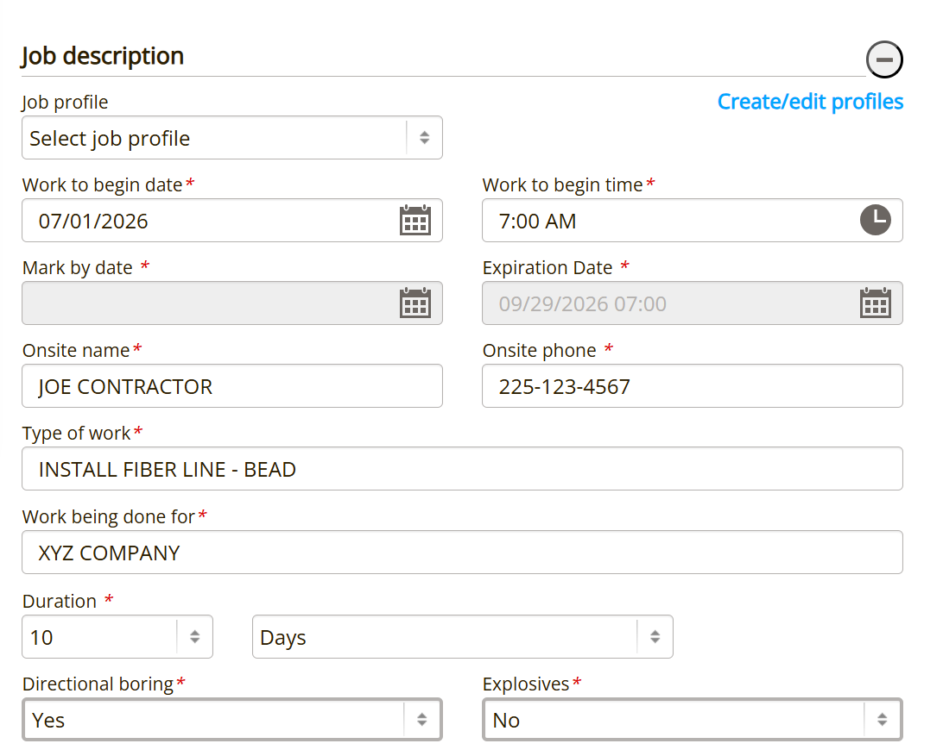
Large Project Ticket
BEAD-funded excavation projects require a specific ticketing process through Louisiana 811 to ensure safe coordination.
Large Project Ticket Process for BEAD Work
BEAD-funded excavation requires use of a Large Project Ticket. Excavators must provide a minimum 30-day advance notice to all 811 members before work begins to ensure full coordination and safety compliance.
11
30-day advance notice required for all BEAD-funded excavation projects.

Slide 13

Written Agreement Requirements
All parties must establish a good faith mutual written agreement before excavation begins on BEAD projects.
Good Faith Written Agreement
01
All parties must attempt a good faith mutual written agreement prior to excavation, ensuring clear roles and responsibilities are established.
Scope & Coordination Details
02
Onsite & Electronic Upload
The agreement defines project scope, mark-by times, and project-specific coordination details to align all stakeholders before work begins.
03
Agreement must be kept onsite and electronically uploaded, attached to the Large Project Ticket for full compliance and documentation.
12

Slide 14
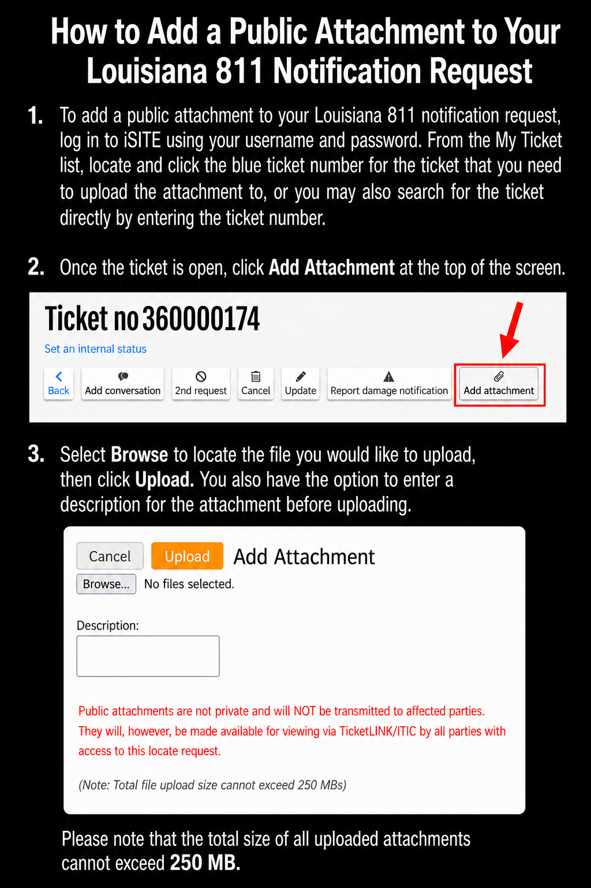
Large Project Ticket
13
30-day advance notice required for all BEAD-funded excavation projects.

Slide 15
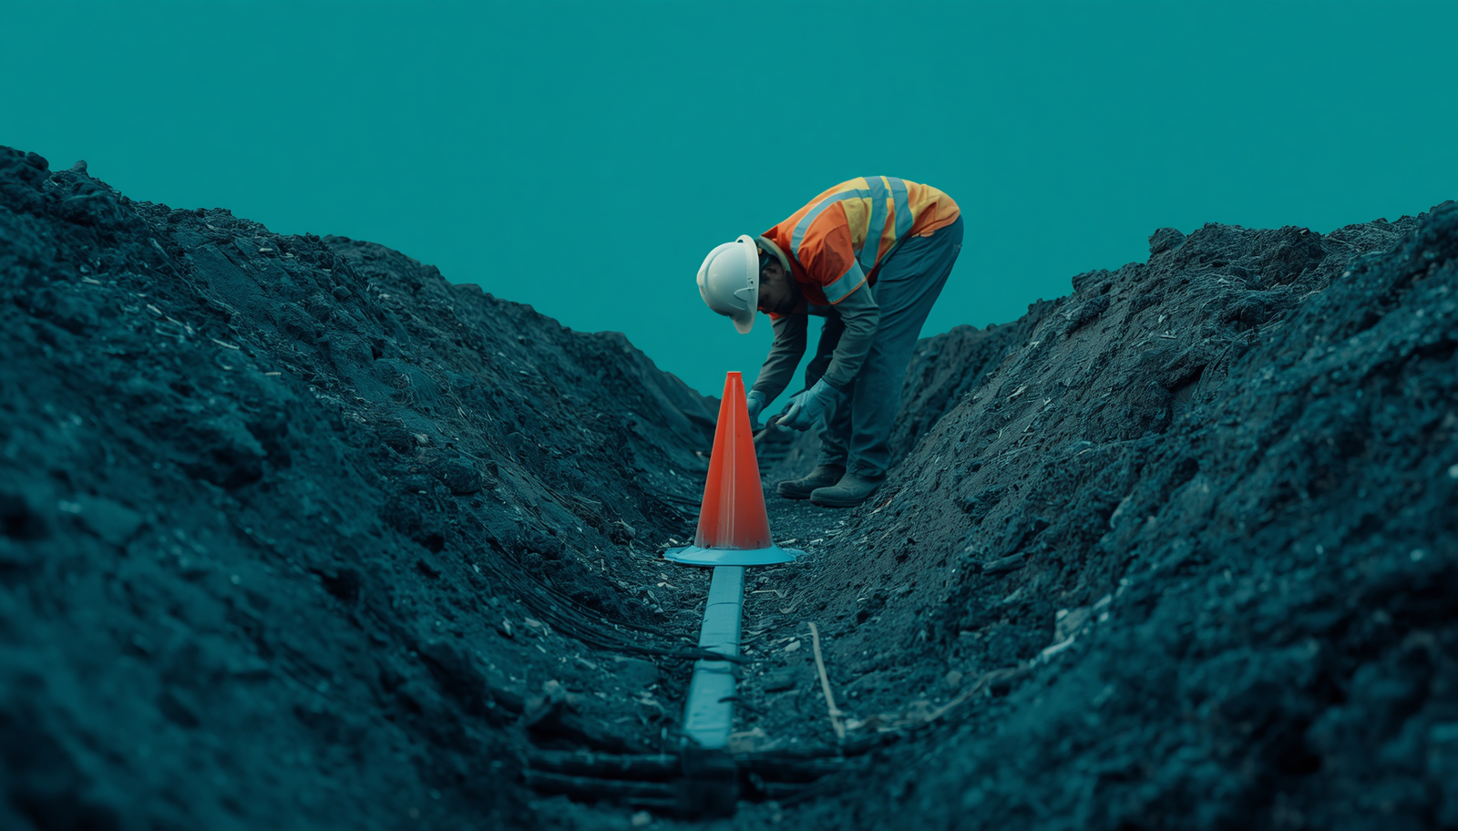
Operator Marking & Positive Response Timing
1.
Notify
If facility markings not visible and no positive response, excavator must notify 811 members
2.
Wait
Operators have 3 hours to mark facilities or confirm no conflict with excavation area
3.
Proceed
If no operator response within 3 hours, excavation may proceed with caution
14
4.
Safety
Balances prompt project progression with infrastructure safety requirements

Slide 16


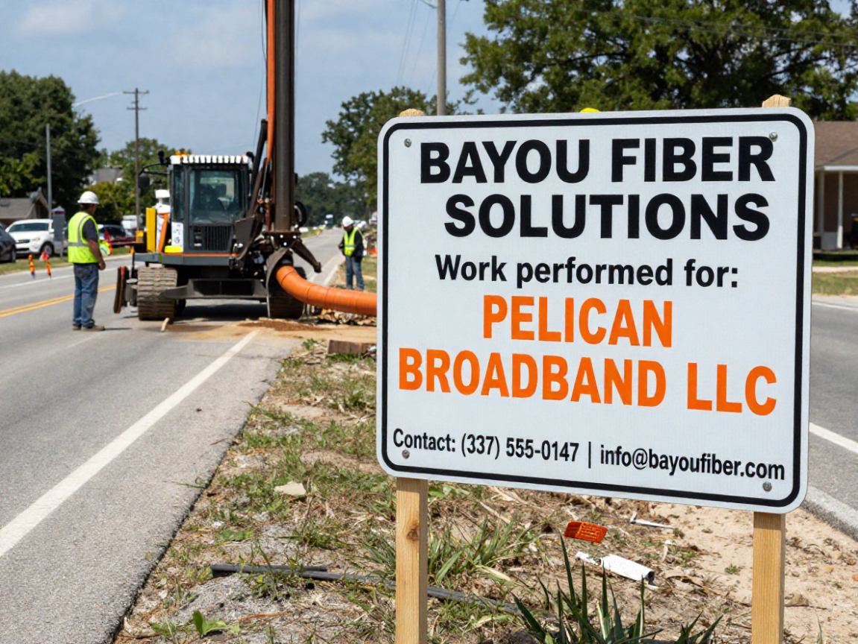


Signage Requirements
Excavator Identification
Broadband Provider Name
Signage must identify the excavator, demolisher, or contractors on site
Display the broadband service provider name on all required signage
Contact Phone Number
Contact Email Address
A valid contact phone number must be visible for public inquiries
Contact email for inquiries must be included on displayed signage
15

Slide 17

Importance of Member Participation in BEAD Projects
1.
2.
3.
Assign Personnel
Written Agreement Process
Adhere to Requirements
Assign personnel to Large Project Tickets labeled "INSTALL FIBER LINE – BEAD" to ensure timely operator response and coordination.
Participate actively in the written agreement process to define scope, mark-by times, and project-specific coordination details.
Adhere to mark-by times and project requirements. Protect infrastructure and enable broadband deployment success.
16

Slide 18
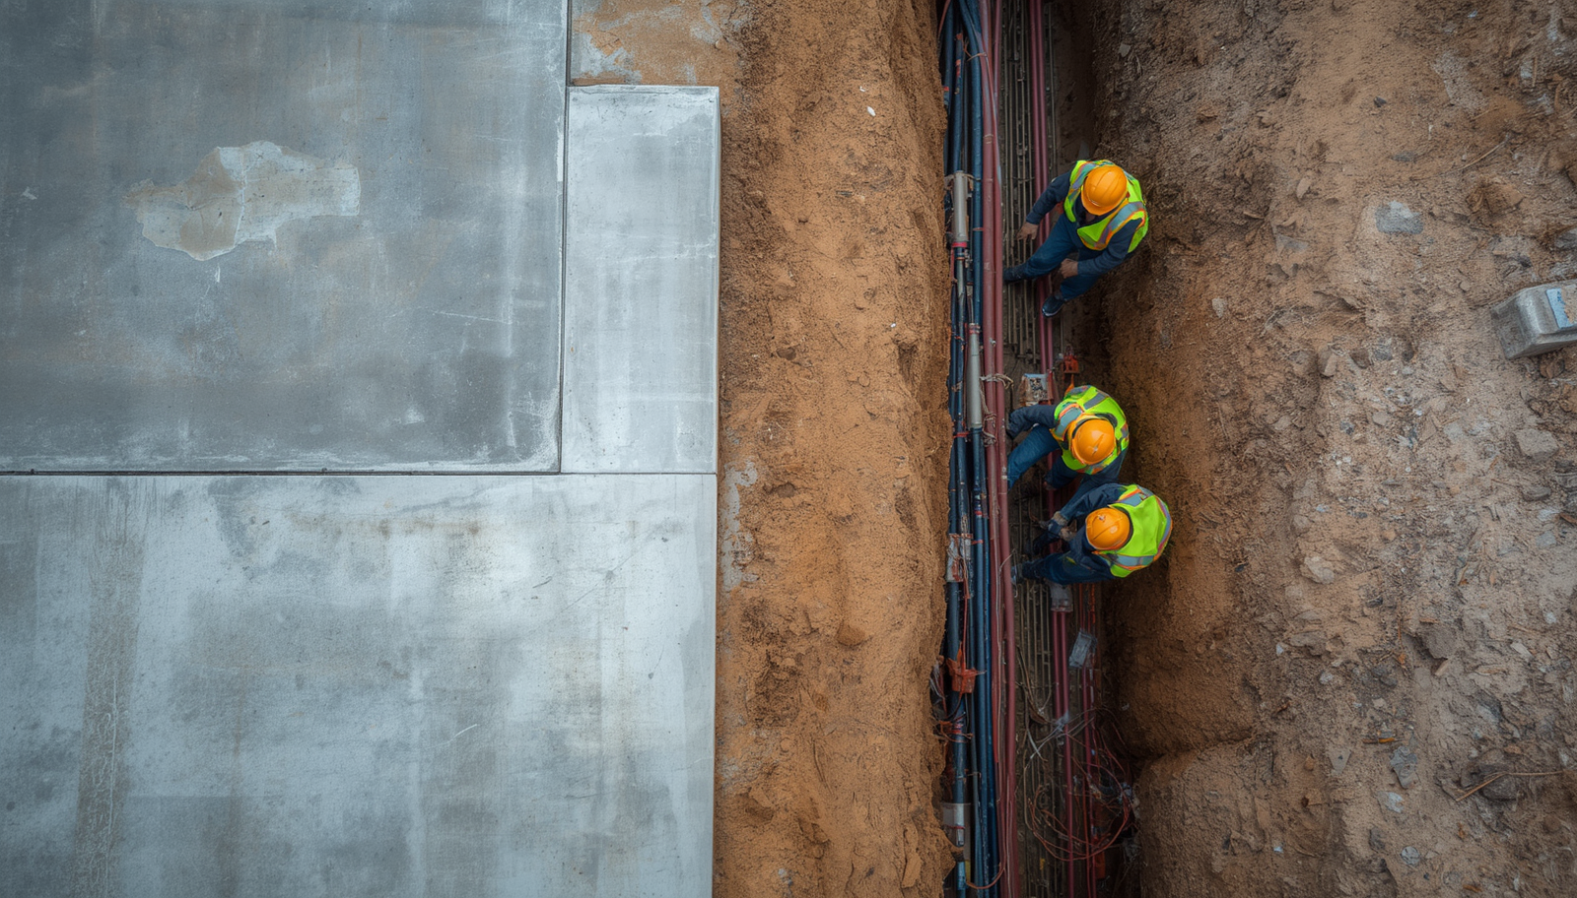
Summary of Key Changes
A concise recap of the main legislative amendments under SB469 & HB464.
03
01
05
Enforcement officers can halt unsafe excavation
Positive Response mandatory for all members
02
04
Damage Reporting
Requires that Louisiana
811 be contacted
When damage to an
Underground utility
occurs.
Mandatory membership expanded (with exceptions)
BEAD projects require advanced coordination & signage
17

Slide 19
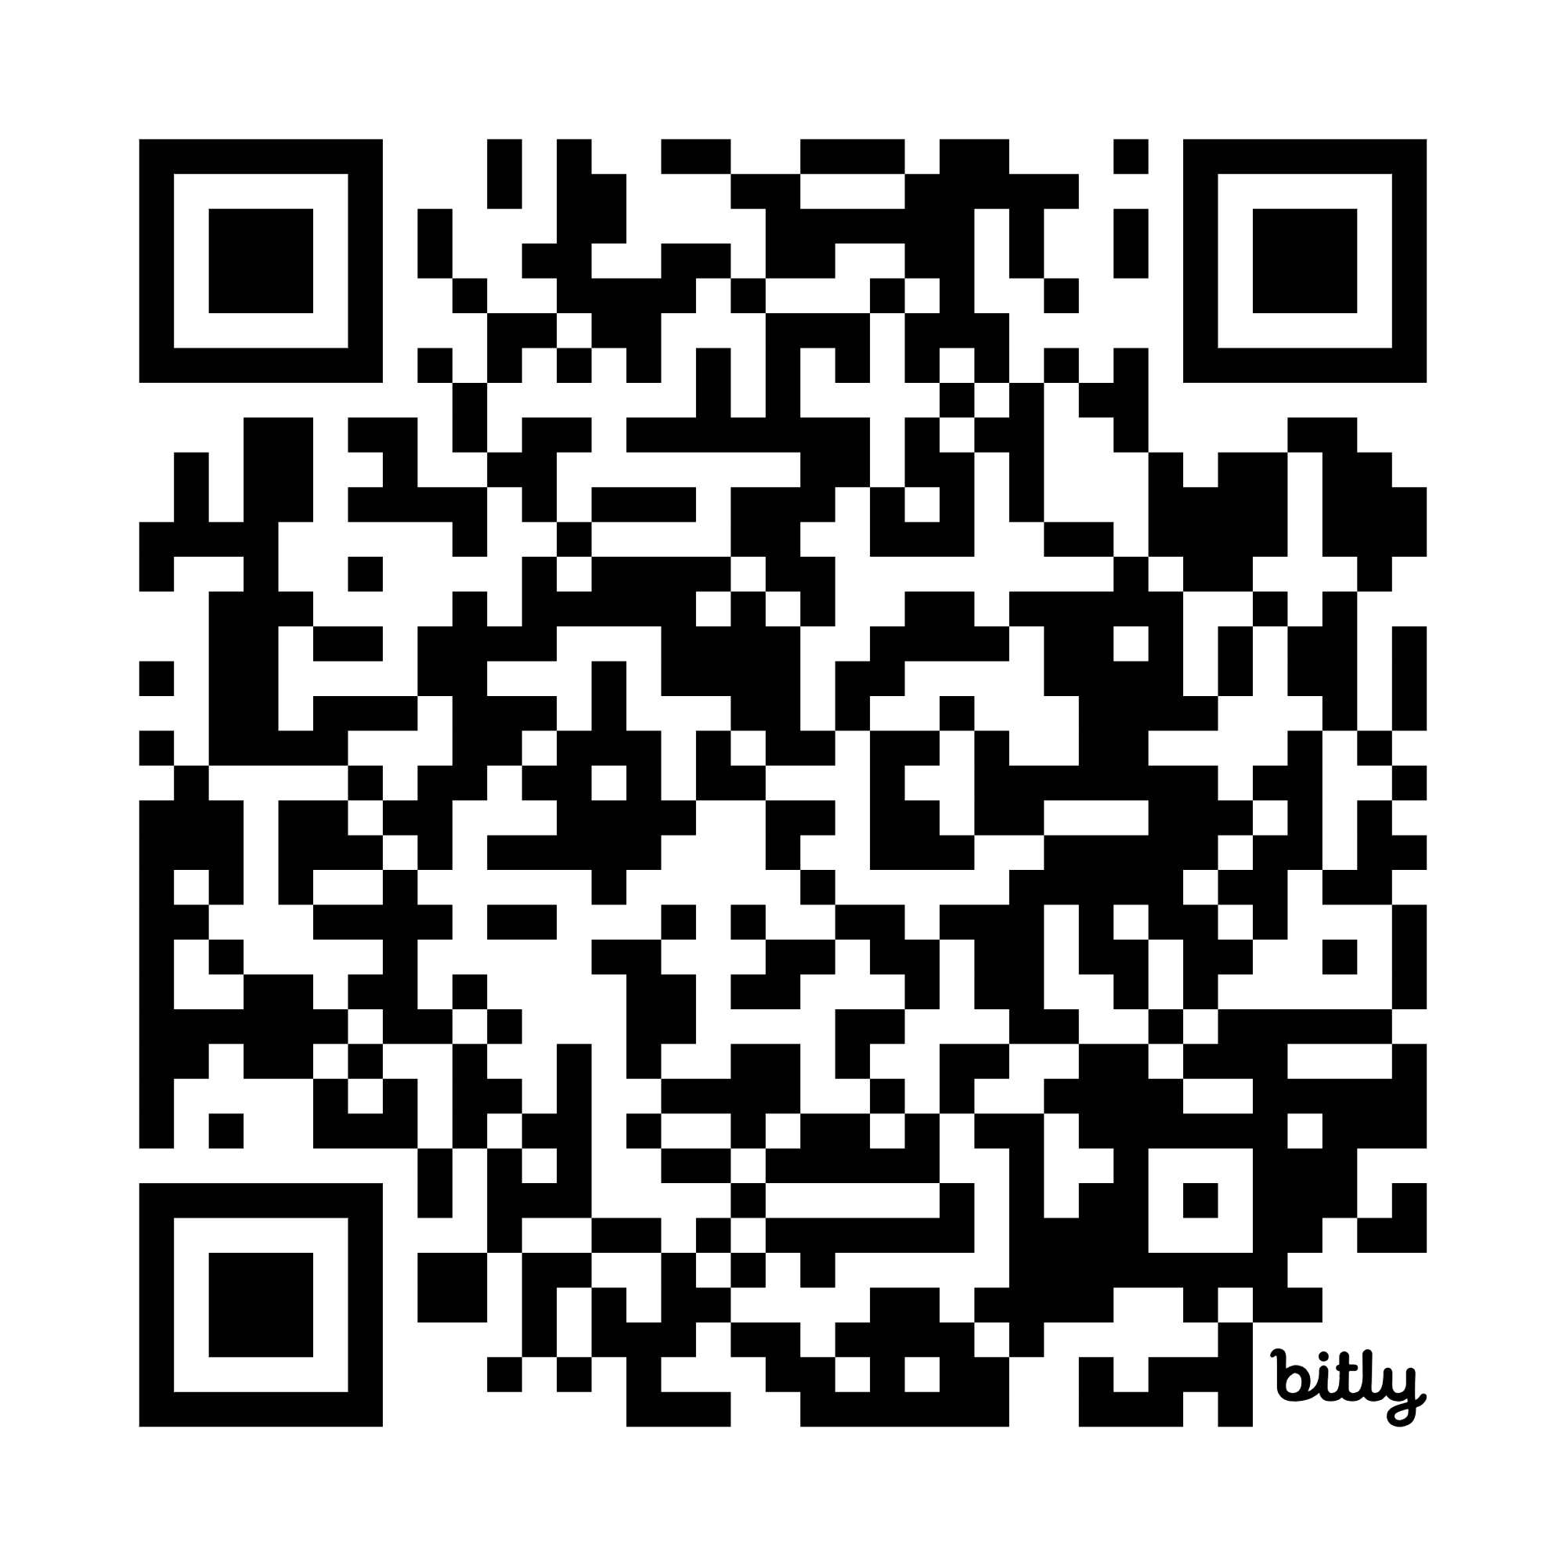
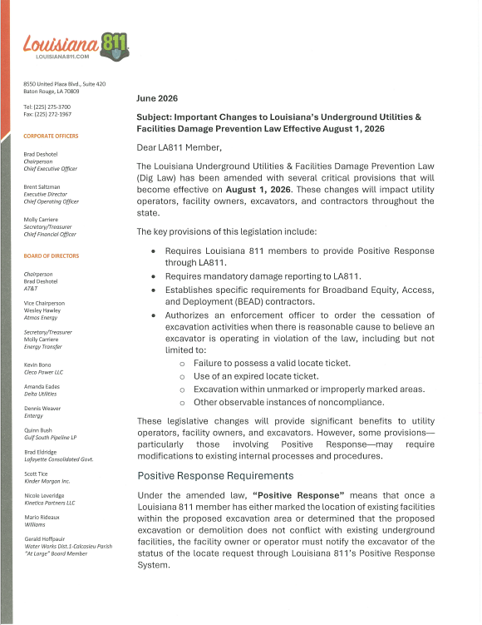
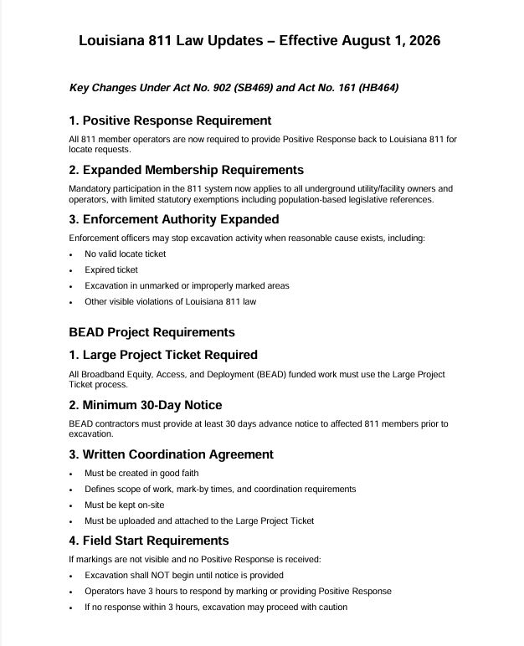
Resources
This Presentation:
https://bit.ly/2026LA811LawChanges
from the desk of BRENT SALTZMAN
CHEAT SHEET
THE LETTER

